Slide 1
Password Cracking ++
Antu Prabha

Slide 2
Encryption vs Encoding vs Hashing

Slide 3
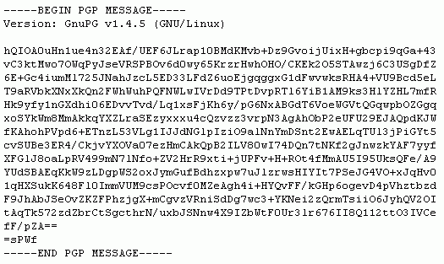

Encryption
Encrypting = mapping of input data and output data reversible with a key

Slide 4
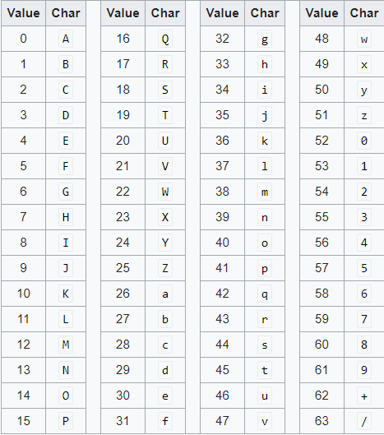
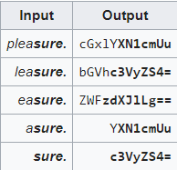
Encoding
Encoding = transforms data into a publicly known scheme for usability

Slide 5
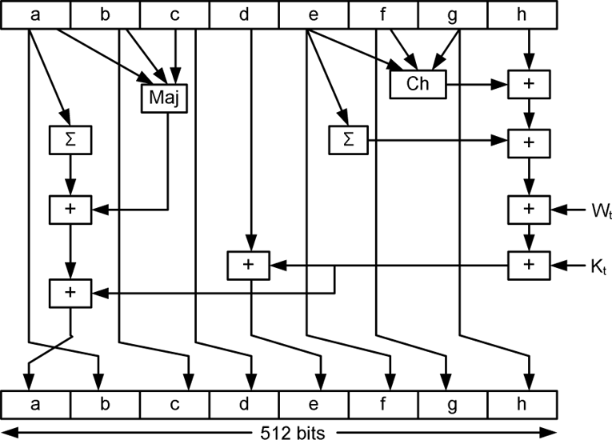
Hashing
Hashing = one-way cryptographic function nearly impossible to reverse
hash("hello") = 2cf24dba5fb0a30e26e83b2ac5b9e29e1b161e5c1fa7425e73043362938b9824
hash("hbllo") = 58756879c05c68dfac9866712fad6a93f8146f337a69afe7dd238f3364946366
hash("waltz") = c0e81794384491161f1777c232bc6bd9ec38f616560b120fda8e90f383853542

Slide 6
Hash Identification
There isn’t a foolproof method for identifying which hash function was used by simply looking at the hash, other than few reliable clues
(i.e. $6$ sha512crypt).
The best method is to know from where the hash was extracted and identify the hash function for that software.

Slide 7
Password Cracking ++
Through out the years of effort we have successfully trained everyone to use passwords that are hard for human to remember,
but easy for computers to guess

Slide 8
Password Attack types
Dictionary = Checks each word in a wordlist
Hybrid/rules = Augments wordlists by adding characters before/after words
Markov = Uses machine learning to assemble possible guesses
Mask = Attacks the structure of a password’s character composition
Brute Force = Tries every possible combination of characters

Slide 9
DICTIONARY/WORDLIST vs BRUTE-FORCE vs ANALYSIS
Dictionaries and brute-force are not the end all be all to crack hashes. They are merely the beginning and end of an attack plan.
True mastery is everything in the middle, where analysis of passwords, patterns, behaviors, and policies affords the ability to recover till that last hash.
Experiment with your attacks and research and compile targeted wordlists with your new knowledge.
Do not rely heavily on dictionaries because they can only help you with what is “known” and not the unknown.

Slide 10
Dictionary Attack
Dictionary Attack
Trying apple : failed
Trying blueberry : failed
Trying justinbeiber : failed
...
Trying letmein : failed
Trying s3cr3t : success!

Slide 11
Rainbow Tables, Lookup Tables & Reverse Lookup Tables
Lookup Tables
Searching: 5f4dcc3b5aa765d61d8327deb882cf99: FOUND: password5 Searching: 6cbe615c106f422d23669b610b564800: not in database Searching: 630bf032efe4507f2c57b280995925a9: FOUND: letMEin12 Searching: 386f43fab5d096a7a66d67c8f213e5ec: FOUND: mcd0nalds Searching: d5ec75d5fe70d428685510fae36492d9: FOUND: p@ssw0rd!
Reverse Lookup Tables
Searching for hash(apple) in users' hash list... : Matches [alice3, 0bob0, charles8] Searching for hash(blueberry) in users' hash list... : Matches [usr10101, timmy, john91] Searching for hash(letmein) in users' hash list... : Matches [wilson10, dragonslayerX, joe1984] Searching for hash(s3cr3t) in users' hash list... : Matches [bruce19, knuth1337, john87] Searching for hash(z@29hjja) in users' hash list... : No users used this password

Slide 12
CRACKING METHODOLOGY
Hash Cracking Speed (Slow-Fast)
Based on known or unknown knowledge
Extract Hashes
Format Hashes
Evaluate Hash Strength
Calculate RIG Capabilities
Formulate Plan
Analyze Password
Custom attacks
Advanced Attacks
Repeat ( from step 4)
Experiment with Princeprocessor, custom Markov-chains, maskprocessor, or custom
dictionary attacks to shake out those remaining stubborn hashes. This is where your
expertise and creativity really come into play.
Analyze cracked passwords, to create new plan
Based clues
or patterns create custom mask attacks or rules to fit target users’
behavior or preferences.

Slide 13
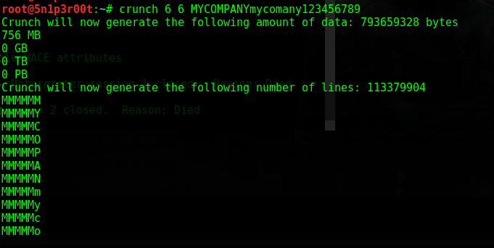
Password Profiling
Crunch

Slide 14
Password Profiling

Slide 15
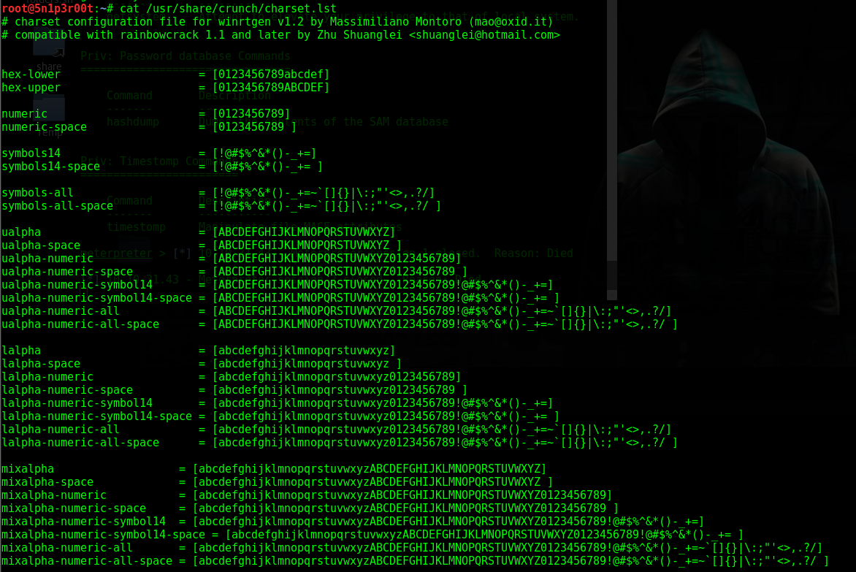
Password Profiling

Slide 16
Password Profiling
Cewl – is an another good tool to generate passwords from websites related to target/ victims

Slide 17
Hashcat
Worlds first only in-kernel rule engine
Multi platform from Raspberry Pi till GPU RIG / mines.
Multi hash cracking simultaneously
Support distributed cracking network
Supports session and restore
200+ hash types supported

Slide 18
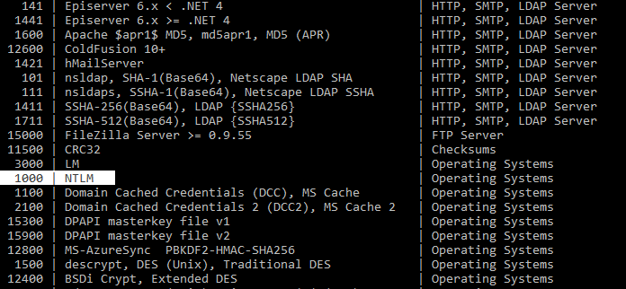
Hashcat required minimum 4 Arguments
1st Argument is –m ( or –Hash—Type)
For example, MD5, SHA1, etc.
Full list of hash types can be found by using “—help”
Currently supports 237+ different hash types
Usage -m 1000 ( NTLM hashes)

Slide 19
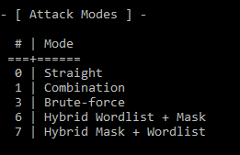
Hashcat required minimum 4 Arguments
2nd Argument is –a ( or –Attack—Mode)
Method to crack passwords.
Example :- using dictionary of words or Brute force
Usage -a 1 (Combination attacks)

Slide 20
Hashcat required minimum 4 Arguments
3rd Argument ./path/filename.txt
The path which contains the hashfile.
4th Argument [Dictionary | Mask | Word file]
Specify a dictionary, mask or a directory to be used

Slide 21
Masks
MASK ATTACK a form of targeted brute-force attack by using placeholders for characters in certain positions (i.e. ?a?a?a?l?d?d).
?l = abcdefghijklmnopqrstuvwxyz
?u = ABCDEFGHIJKLMNOPQRSTUVWXYZ
?d = 0123456789
?s = !"#$%&'()*+,-./:;<=>?@[]^_`{|}~
?a = ?l?u?d?s
( all characters )

Slide 22
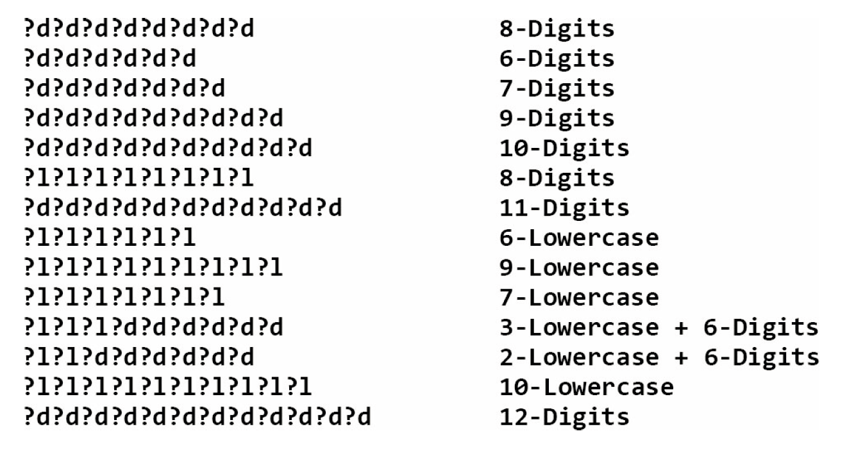
Masks
MASK ATTACK a form of targeted brute-force attack by using placeholders for characters in certain positions (i.e. ?a?a?a?l?d?d).

Slide 23
Masks
hashcat -a 3 -m 0 -w 4 hash.txt rockyou-1-60.hcmask

Slide 24
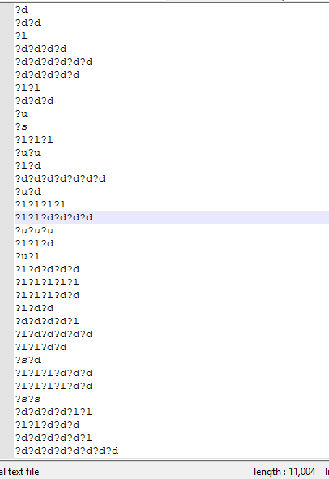
Masks
hashcat -a 3 -m 0 -w 4 hash.txt rockyou-1-60.hcmask

Slide 25
Masks
Why to use them – not how
Masks are often used in Hashcat, and one can greatly benefit from it if they know how to use them
Masks are usually a simple topic, but too many people still don’t know how to use them, or why

Slide 26
Masks
Imagine you want to configure a program to generate all words of the range:
Aaa-zzz
There are many ways to do it, for example:
It could have the ability to set a charset (alpha)
It could have the ability to set a password length.

Slide 27
Rules
The rule-based attack is one of the most complicated of all the attack modes. The reason for this is very simple.
The rule-based attack is like a programming language designed for password candidate generation.
It has functions to modify, cut or extend words and has conditional operators to skip some, etc. That makes it the most flexible, accurate and efficient attack.

Slide 28
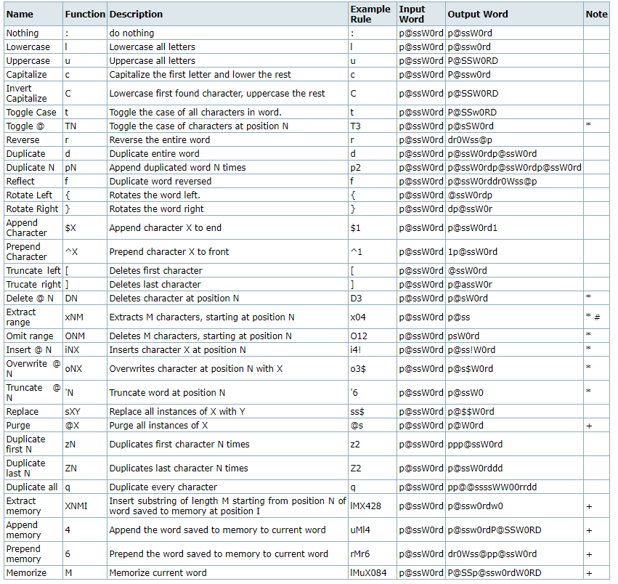
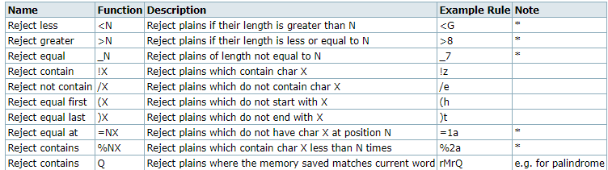
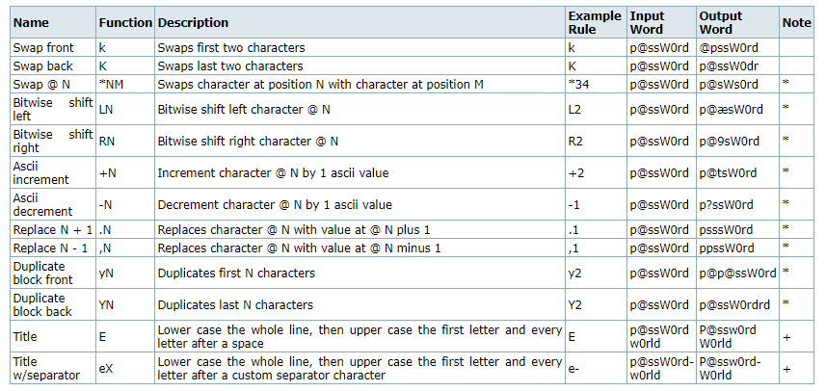
Rules Creation & Output

Slide 29
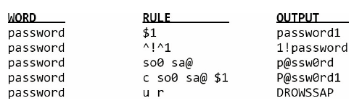
Rules Creation & Output

Slide 30
Rules Creation & Output
hashcat -a 0 -m <#hash type> -r <#rule file> hash.txt dict.txt
hashcat -a 0 -m 1000 <NTLMHASHES> wordlists/rockyou.txt -r hob064.rule -o cracked.txt
hashcat -a 0 -m 1000 <NTLMHASHES> wordlists/english.txt -r d3adhob0.rule -o cracked.txt

Slide 31
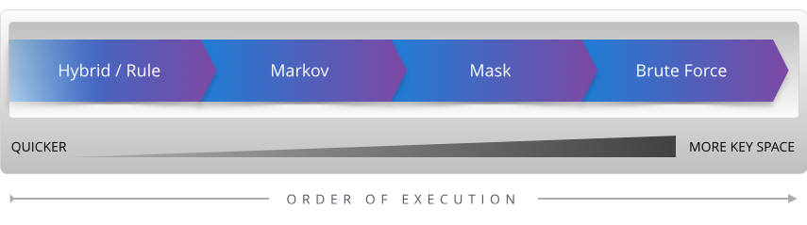
Statistics can crack your Password
25-GPU cluster presented can crack NTLM hash generation speed of 350 billion hashes per second compared to a Bcrypt hash generation speed of 71,000
In other way every single Bcrypt hash generated, 5 million NTLM hashes can be generated.

Slide 32
Statistics can crack your Password
If an attacker knows the length of a password is significantly short enough such that brute forcing the key space would not take very long there is no need to take incremental attack steps.

Slide 33
Password Attack types – Defense Method
Adding Salt
hash("hello") = 2cf24dba5fb0a30e26e83b2ac5b9e29e1b161e5c1fa7425e73043362938b9824
hash("hello" + "QxLUF1bgIAdeQX") = 9e209040c863f84a31e719795b2577523954739fe5ed3b58a75cff2127075ed1
hash("hello" + "bv5PehSMfV11Cd") = d1d3ec2e6f20fd420d50e2642992841d8338a314b8ea157c9e18477aaef226ab
hash("hello" + "YYLmfY6IehjZMQ") = a49670c3c18b9e079b9cfaf51634f563dc8ae3070db2c4a8544305df1b60f007

Slide 34
Password Attack types – Salt weakness
Salt Reuse
A common mistake is to use the same salt in each hash. Either the salt is hard-coded into the program, or is generated randomly once. This is ineffective because if two users have the same password, they'll still have the same hash. An attacker can still use a reverse lookup table attack to run a dictionary attack on every hash at the same time.
Short Salt
If the salt is too short, an attacker can build a lookup table for every possible salt. For example, if the salt is only three ASCII characters, there are only 95x95x95 = 857,375 possible salts. That may seem like a lot, but if each lookup table contains only 1MB of the most common passwords, collectively they will be only 837GB, which is not a lot considering 1 TB hard drives cost nearly 250 AED.

Slide 35
Double Hashing & Wacky Hash Functions
md5(sha1(password))
md5(md5(salt) + md5(password))
sha1(sha1(password))
sha1(str_rot13(password + salt))
md5(sha1(md5(md5(password) + sha1(password)) + md5(password)))
As per internet forums, do not use any of these. Common password hashing misconception: wacky combinations of hash algorithms. It's easy to get carried away and try to combine different hash functions, hoping that the result will be more secure, but actually not.

Slide 36
The RIGHT Way: How to Hash Properly
The Basics: Hashing with Salt
To Store a Password
Generate a long random salt using a CSPRNG ( Pseudo-Random Number).
Prepend the salt to the password and hash it with a standard password hashing function
Save both the salt and the hash in the user's database record.
To Validate a Password
Retrieve the user's salt and hash from the database.
Prepend the salt to the given password and hash it using the same hash function.
Compare the hash of the given password with the hash from the database. If they match, the password is correct. Otherwise, the password is incorrect.
Notes:
Cryptographically Secure Pseudo-Random Number Generator

Slide 37


Slide 38


